Slide 1
Ski Jumping Simulation
Demetrios Koziris

Slide 2
The Problem The Hill

Slide 3
The Takeoff The Jump In the Air

Slide 4
Results Discussion

Slide 5
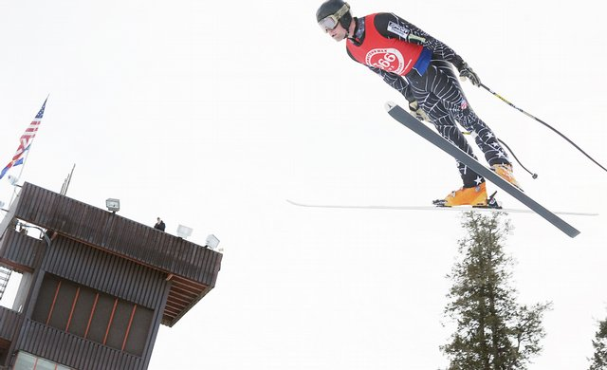
The Problem

Slide 6
The Problem
How does the mass of a ski jumper affect his distance?
Ski jumpers have found that their mass plays a significant role in determining their jump distance
This has caused problems with ski jumpers reducing their weight to unhealthy levels
We want to explore the effect the mass of the skier has on their ski jumping

Slide 7
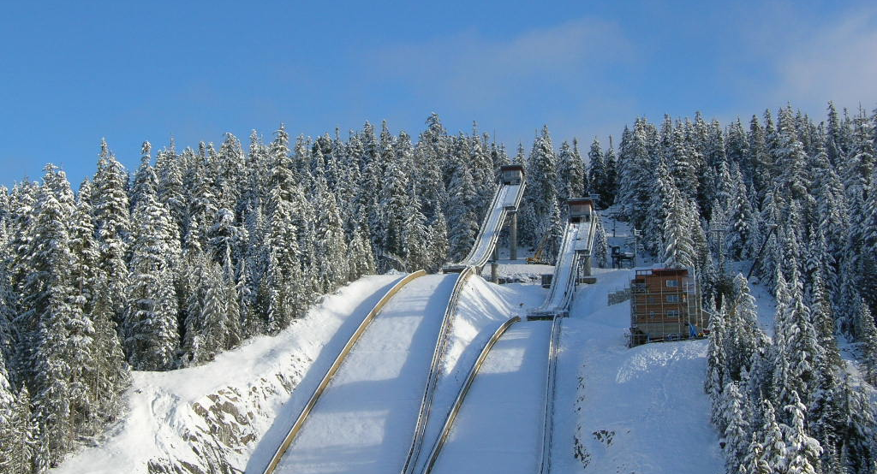
The Hill

Slide 8
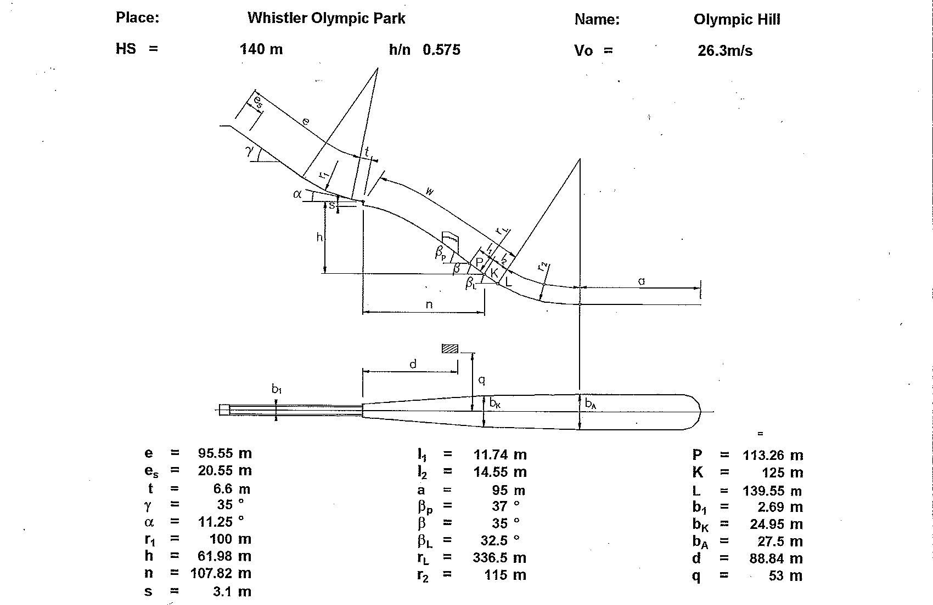
The Hill

Slide 9
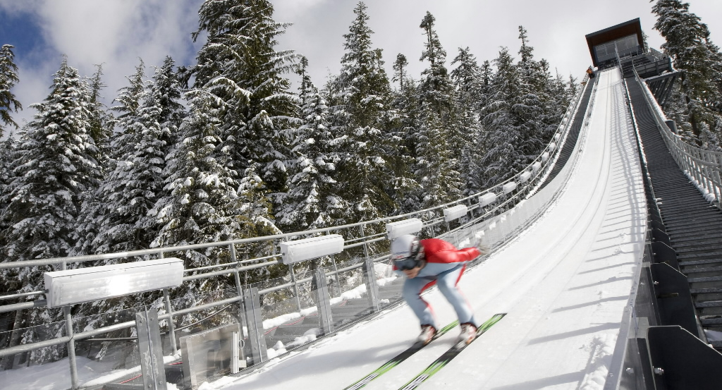
The Takeoff

Slide 10
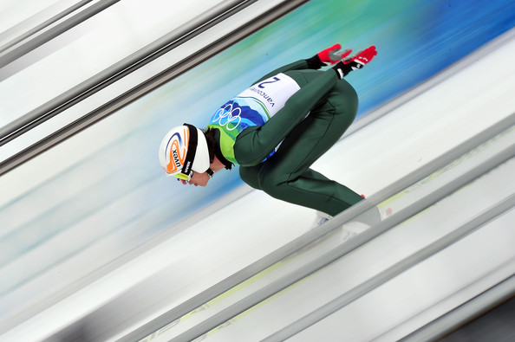
The Takeoff: The Physical Model
Normal Force
Drag Force
Friction Force
Weight

Slide 11
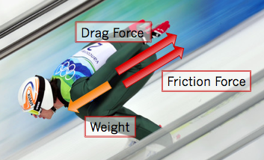
The Takeoff: The Physical Model
Forces in the direction of the hill
F_{weight} = sin(slopeAngle)*mass*g
F_{friction} = frictionCoefficient*cos(slopeAngle)*mass*g
F_{drag} = 0.5*airDensity*frontalArea*DragCoefficient*Velocity²

Slide 12
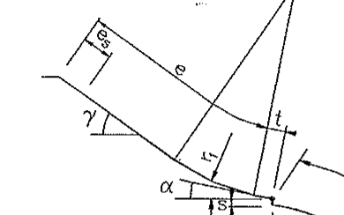
The Takeoff: Implementation
Numerical Method: Euler’s Method
Choose dt
Calculate acceleration = F_{NET}/mass
Calculate velocity = vel + acc*dt
Calculate distance = distance + vel*dt + 0.5*acc*dt²

Slide 13
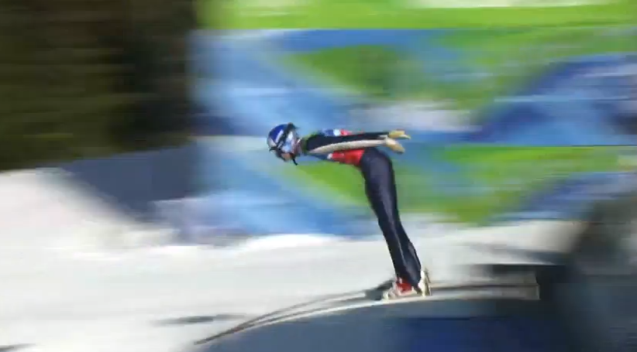
The Jump

Slide 14
The Jump: The Physical Model
Velocity due to Jump
Velocity before Jump
11.25°

Slide 15
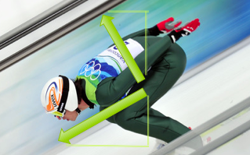
The Jump: Implementation
Calculate velocity due to jump using Newton’s laws
Calculate x and y components after jump
vel_{X} = takeoffVel_{X} + jumpVel_{X}
vel_{Y} = takeoffVel_{Y} + jumpVel_{Y}

Slide 16
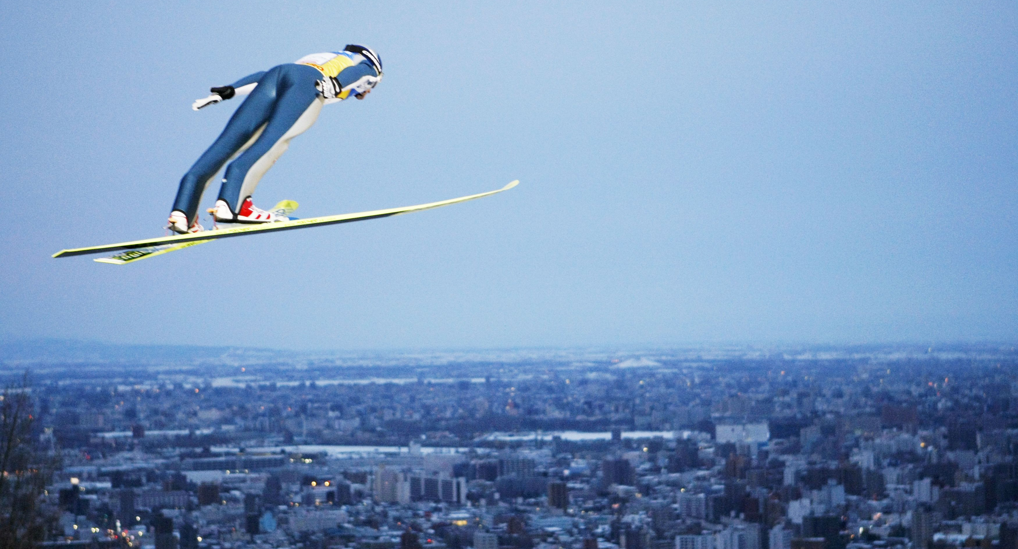
In The Air

Slide 17
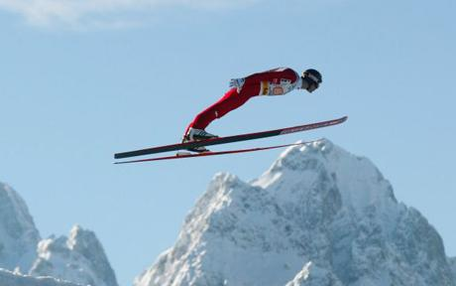
In The Air: The Physical Model
Drag Force
Lift Force
Velocity
Weight

Slide 18
In The Air: Implementation
F_{drag} = 0.5*airDensity*frontalArea*dragCoeff*velocity²
F_{lift} = 0.5*airDensity*frontalArea*liftCoeff*velocity²
Numerical Method: Euler’s Method
Choose dt
Calculate acceleration x and y components
Calculate velocity x and y components
Calculate position in terms of x and y

Slide 19
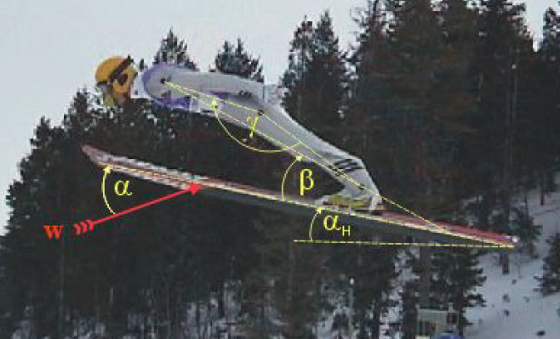
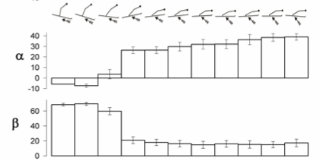
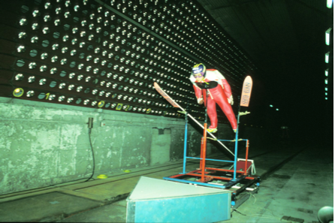
In The Air: Implementation
Angle of Attack
dragCoeff  0.0103
liftCoeff  -0.00025²  0.0228  0.092

Slide 20
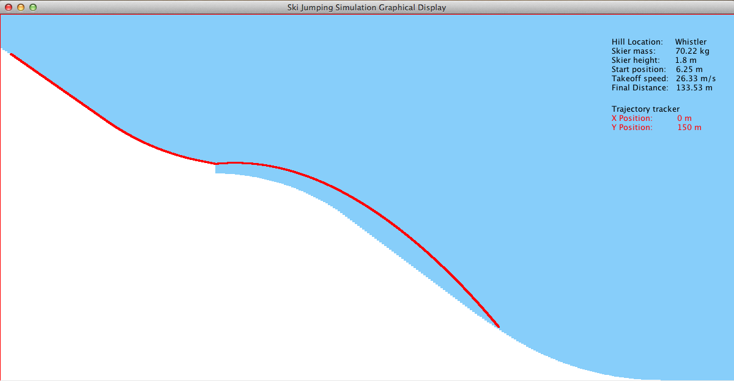
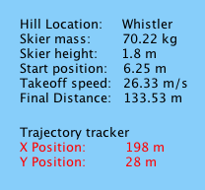
RESULTS

Slide 21
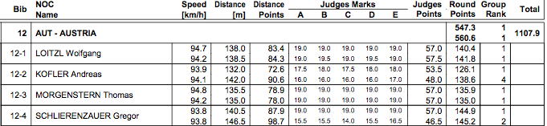
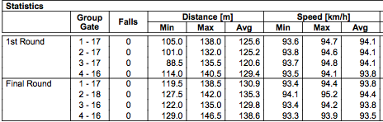
Compared to Real Data

Slide 22
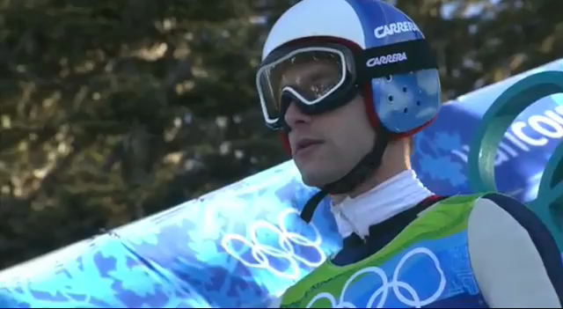
Compared to Real Data

Slide 23
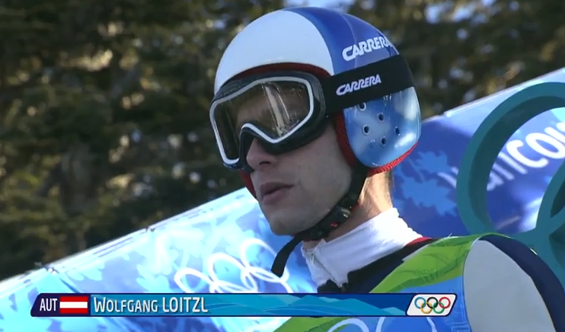
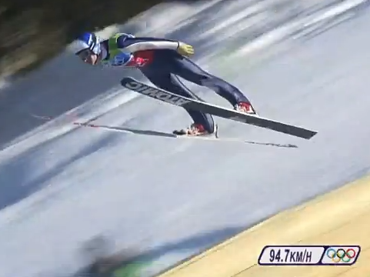
Discussion

